Slide 1

Top 10 cheese
A brief presentation displaying the best cheese
CheeseBuzz
CHEESEBUZZ

Slide 2
The number one dishonorable mention
American
American Cheese is awful, horrendously bad. It is more plastic than cheese and deserves nothing but hatred and scorn

Slide 3
Top 3 cheeses I’ve had mini list
Cheddar
Whatever String Cheese is
The pizza cheese mix from Smith’s

Slide 4

I’m gonna be honest, I don’t know much about cheese

Slide 5
I’m gonna be honest, I don’t know much about cheese
One real good cheese is Mozzarella
Mozzarella is the main squeeze to pizza cheese right? I know mozzarella sticks are very good.

Slide 6
I’m gonna be honest, I don’t know much about cheese
Swiss Cheese
I don’t know how it tastes, but Swiss Cheese is ICONIC so that counts for a lot. If you’re making a cartoon and there’s cheese in it you bet it’s swiss. Sliced swiss, wedged swiss, cubed swiss, wheeled swiss, it all works!

Slide 7
I’m gonna be honest, I don’t know much about cheese
Cheese comes in so many colors, yellow, orange, blue, etc.
Look at all these colors cheese might possibly come in!
Option A
(default)
Option B
Option D
Option C
Option E

Slide 8
I’m gonna be honest, I don’t know much about cheese
What do you think is the cheesiest font?
There are just so many cheesy fonts out there!
Like this one!
and this one!
and this one!
This one is pretty cheesy

Slide 9

Lets take a look at some cheese statistics
Cheese-sticks if you will
Photo credit: John Doe

Slide 10
Cheese-Sticks
The point of showing you cheese statistics is to further visualize cheese in your mind
You will see cheese visuals beyond your puny cheese filled imagination

Slide 11
Cheese-Sticks
Here is a moving picture of cheese
Some call it Gif, others call it Jif
I call it cheese

Slide 12
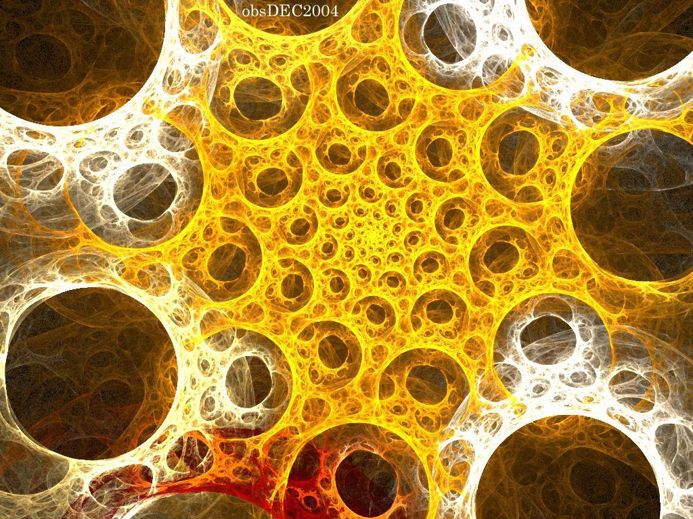
Cheese-Sticks
Here are some more cheese pics
This is the molecular structure of cheese
As you can see the cheese factor or cheese effect as I call it goes all the way down to the molecular level
We have discovered that we can make cheese a fundamental element of the universe

Slide 13
Cheese-Sticks
Here is a diagram of cheese
I want cheese
Sometimes you need help deciding what cheese to cheese when you are feeling your cheesiest
Cheese with holes?
YES
no
Swiss
Cheddar

Slide 14
Cheese-Sticks
The Cycle of Cheese
Product development cycle
Here are a couple of diagrams of how cheese.
The cycle is infinite and cheesy
CHEESE
CURDS
CHEESE
MILK
COW
Customer purchase cycle
Awareness
Consideration
CHEESE
Profit

Slide 15
The Plan:
Step 1: Cheese
Step 2:
Step 3: Profit

Slide 16
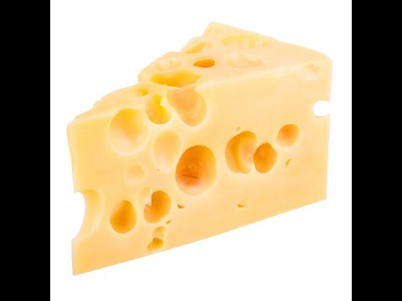
Cheese-Sticks
Cheese videos
Lamp doesn’t work
Here are some cheesetastic cheese videos for your viewing pleasure

Slide 17

Subsequent third act of cheese
Photo credit: John Doe

Slide 18
Act Three
Cheese is objectively so useful
Just look at this animated image showing how cheese can prevent covid-19
As you can see with just 4 layers of cheese you are immune to covid-19
Goodbye masks hello cheese!!

Slide 19
Cheese Act Three
Give your presentation
Sometimes you get stuck in a social situation where your only option is to whip out the cheese.
In scenarios like these you just need to present your cheese with the utmost of confidence

Slide 20
Act Three
Print Cheese
Put cheese in a printer and print cheese
Put string cheese in a 3D printer and 3D print cheese

Slide 21
Act Three
Download cheese in other formats
Instantly download cheese! Click File > Download as, then choose one of the following formats:
Microsoft® PowerPoint® (.pptx)
PDF
Scalable Vector Graphics (.svg)
PNG
JPEG
Text file

Slide 22
Thank you.
For more training and tips on using Cheese,
visit the Cheese Learning Center at https://cheese.com/.

